Slide 1
CPM Motor Configuration
Let's do all the things!

Slide 2
Tuning Overview
(Reference these later)

Slide 3
Recommended Initial Tuning
These tunings should provide a safe ballpark for the tuning, which should then be refined on the water.
 | Posn at 0% PWM | Posn at 100% PWM
Steering | 0 | -13000
Bucket | 0 | -13000
Throttle | -1200 | -5400

Slide 4
New Motor Setup
Fresh out of the box!
Motors should have power and USB connection to a setup laptop running Clearpath MSP 2.0.
Motors should NOT have anything connected to it's output, and should have clear range to actuate without hitting or damaging anything.

Slide 5
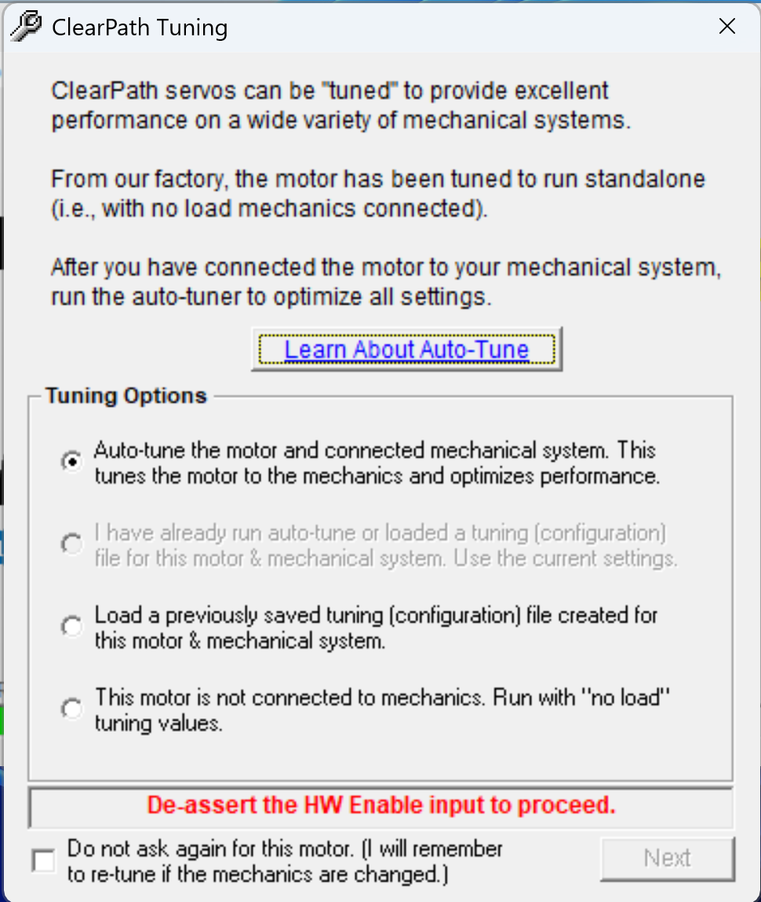
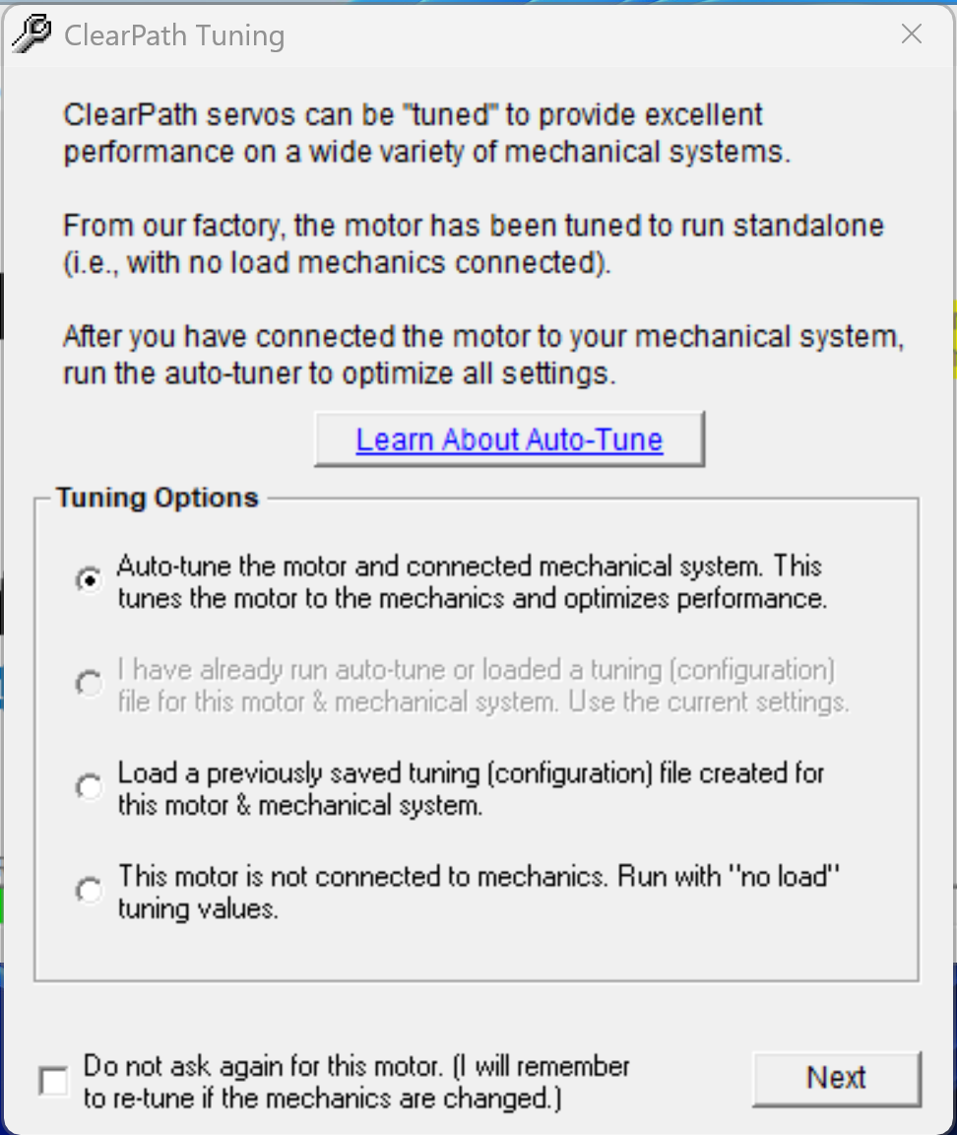
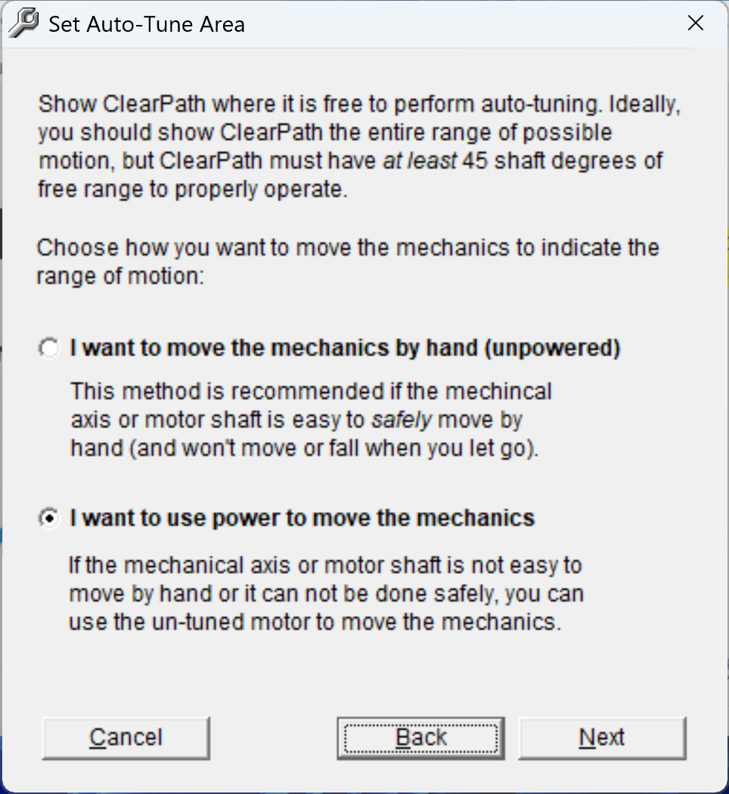
Initial Tuning
Hit next & follow through
Use defaults for most of the panes
Select motor power to perform the tuning range instead of hand powered
Means the enable input is present & must be disconnected.

Slide 6
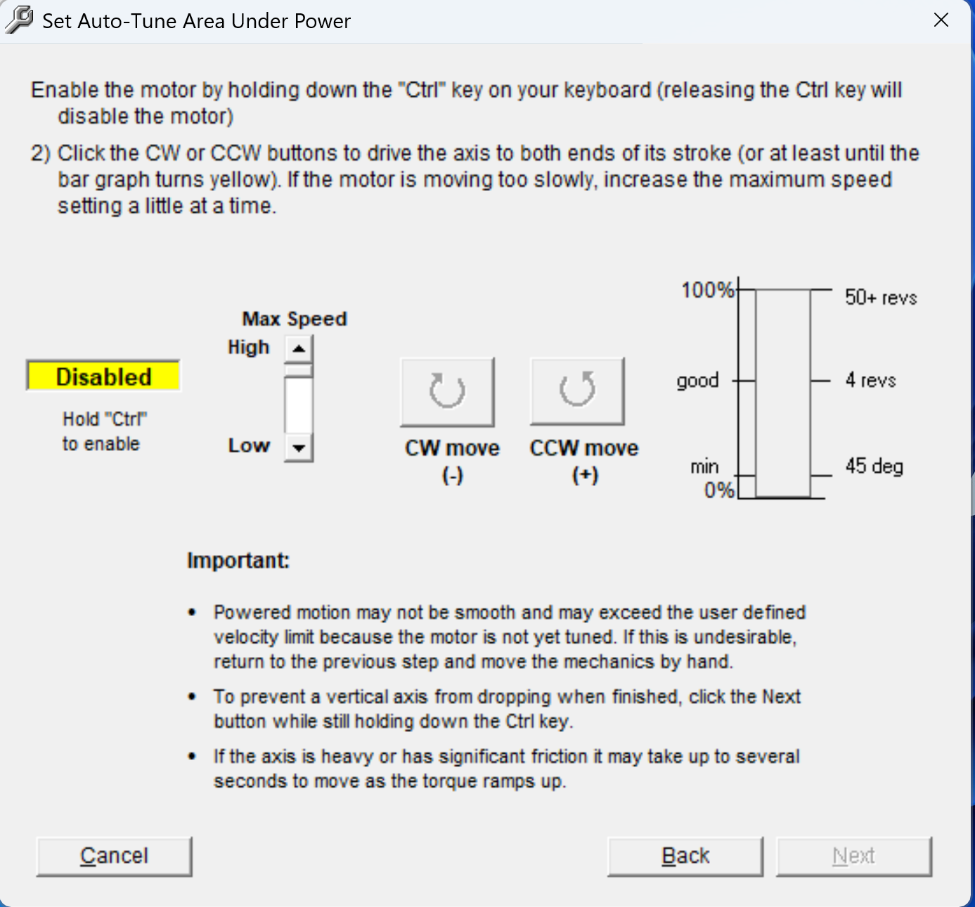
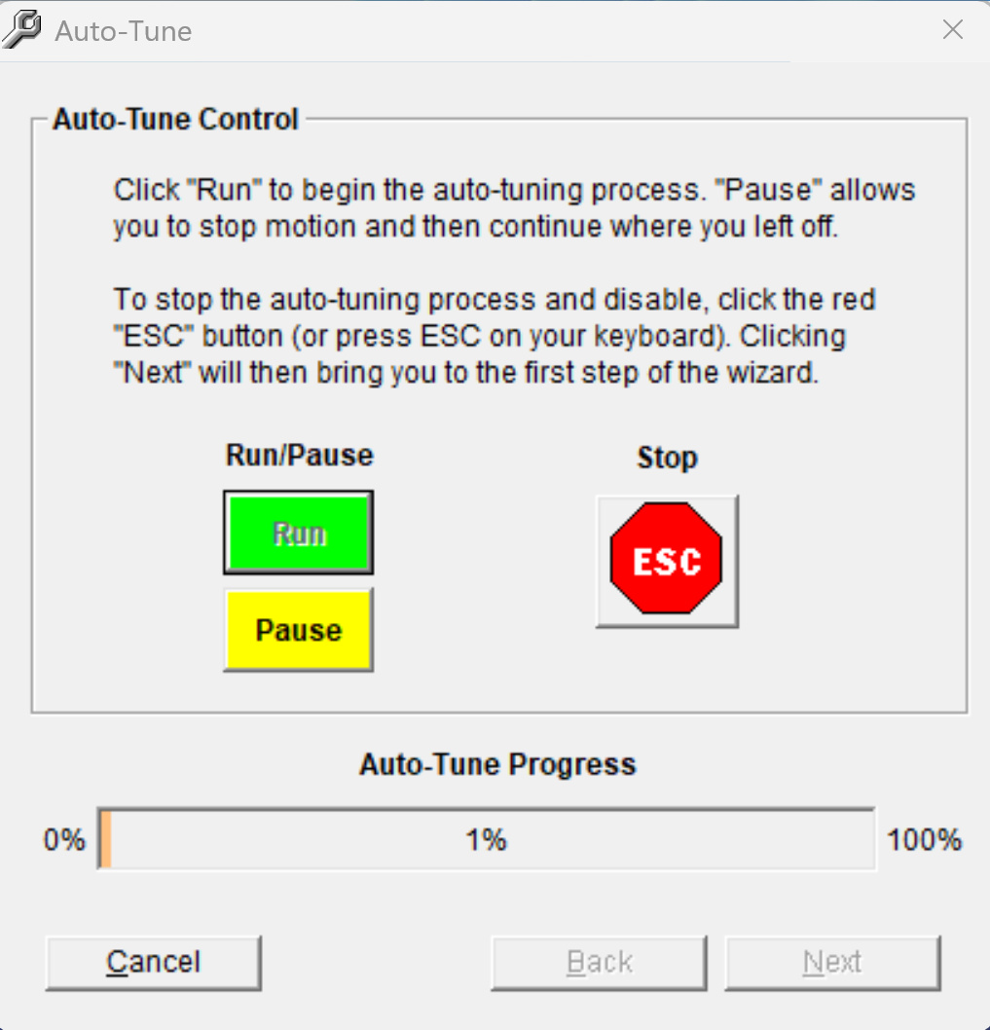
Initial Tuning, Set Area
Set max speed to high (saves you time, not necessary)
Hold in Ctrl & press the CW move button until it is fully extended (it will stop, once it does don't keep holding button)
Then do the same CCW until it fully closes.
Then hit next & use defaults all the way through until auto-tune control where you hit run
Let it do its thing (it'll click & make some noises, totally normal)
Click through till the prompts disappear, disable when prompted & other wise just next / okay.

Slide 7
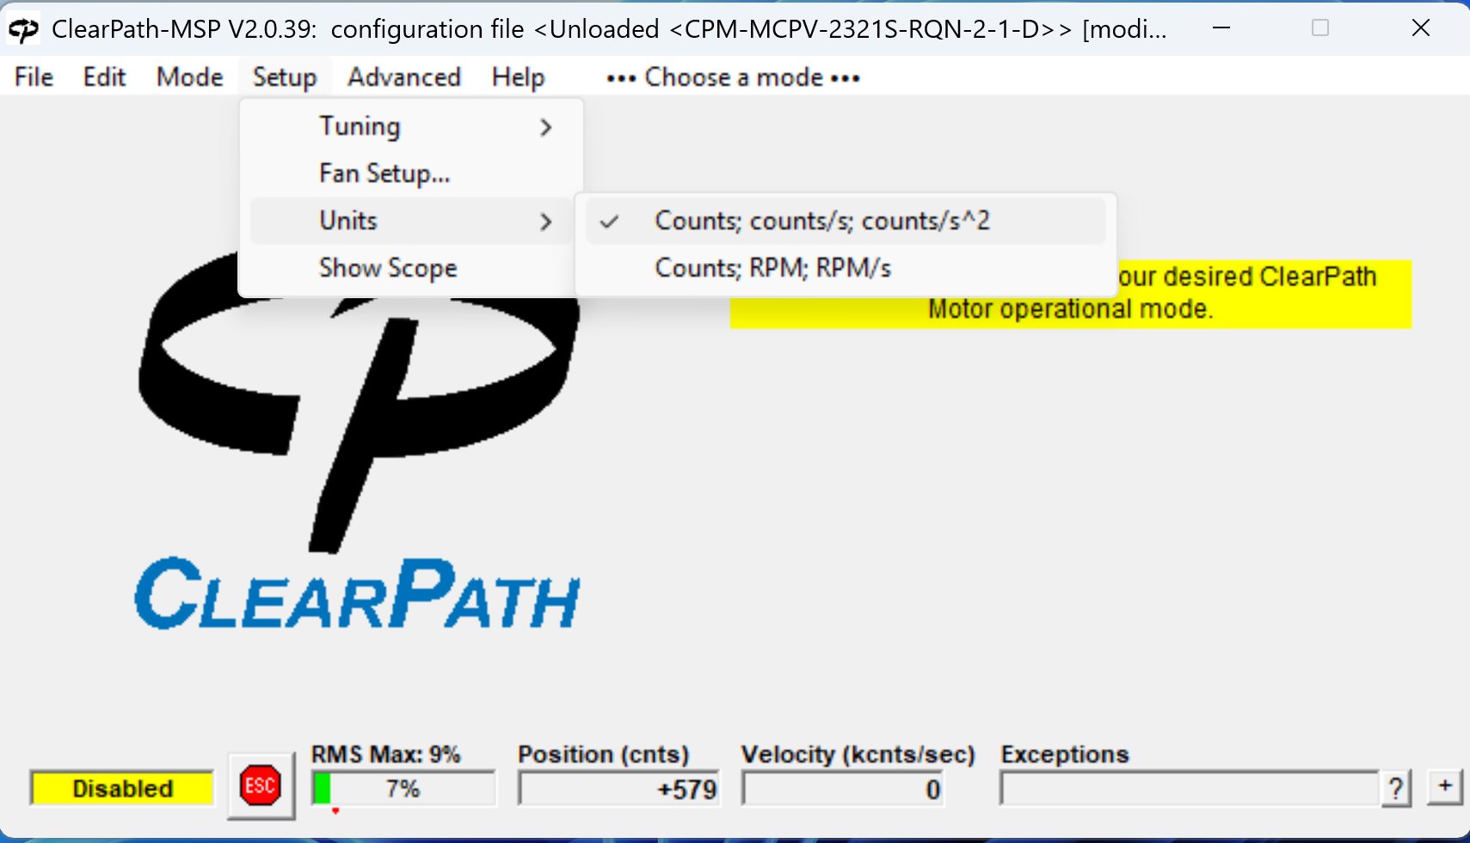
Set Units to Counts

Slide 8
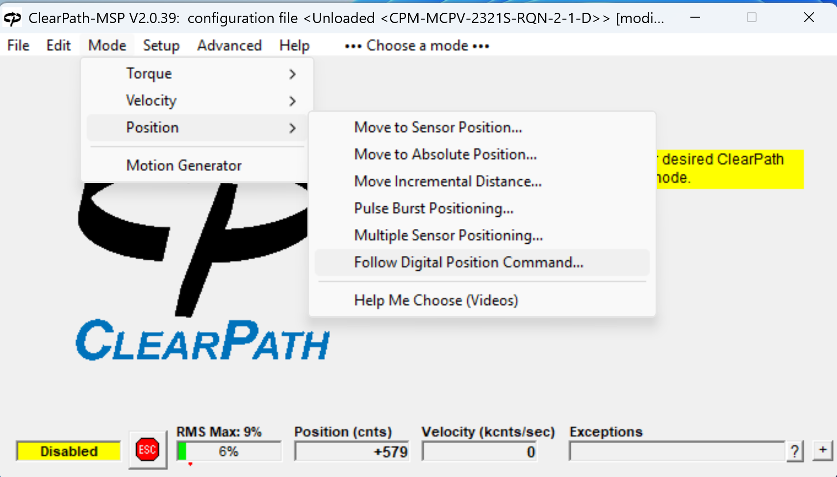
Set To Follow Digital Position Command Mode
Hit okay on the prompt.

Slide 9
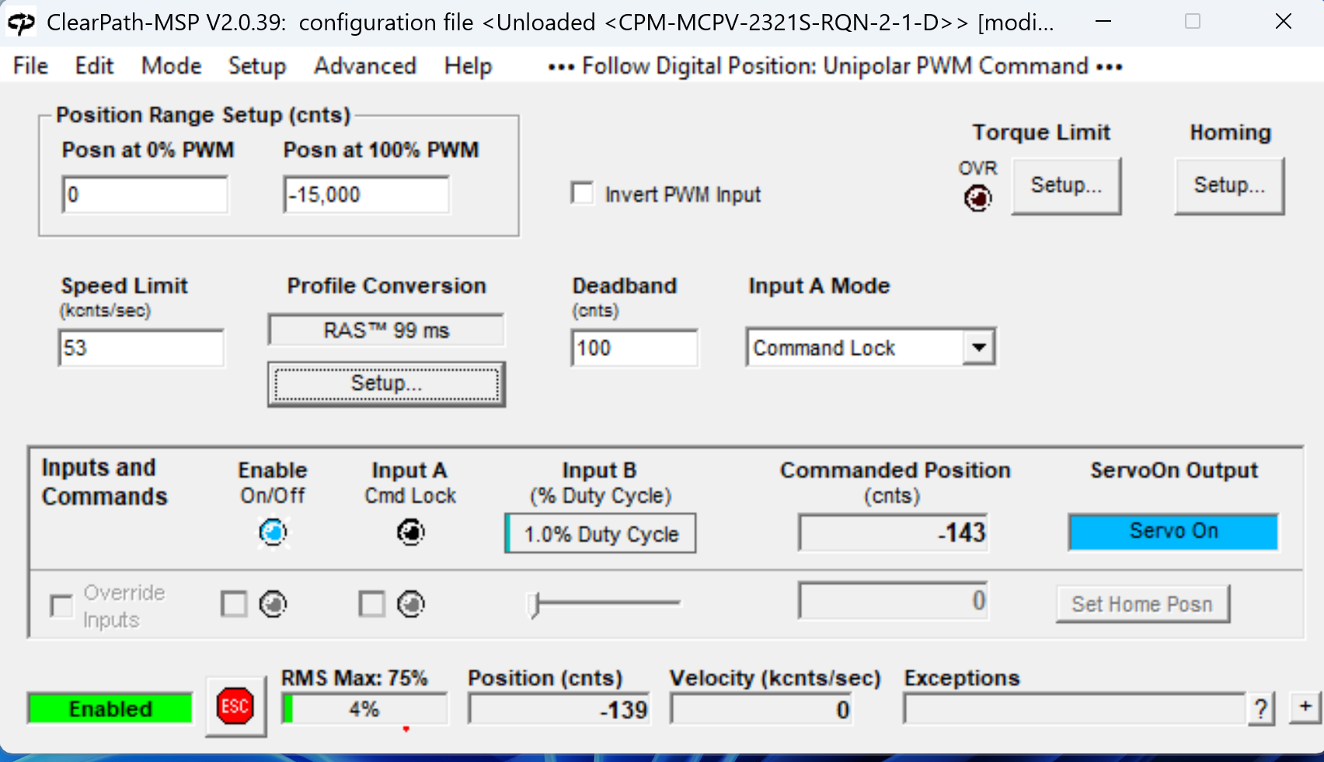
Tune the position range setup
Max the "speed limit" (I put in 100 & let it snap down)
"Posn at 100% PWM", this should be set to the initial value from the table at the start.

Slide 10
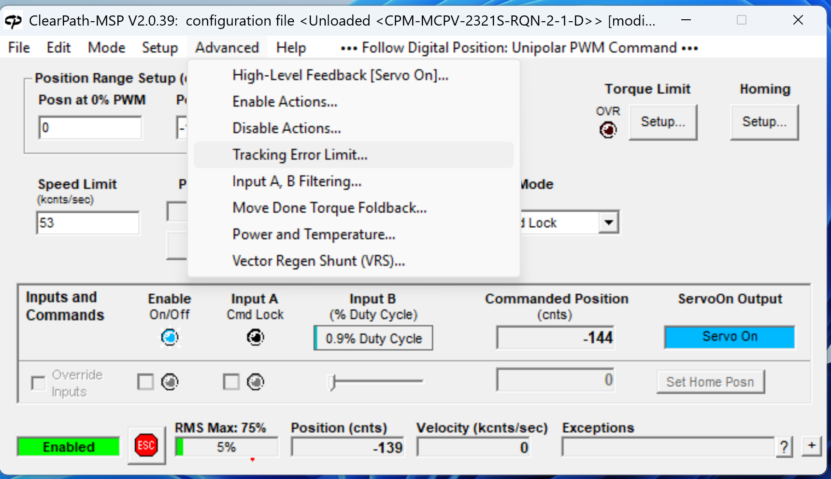
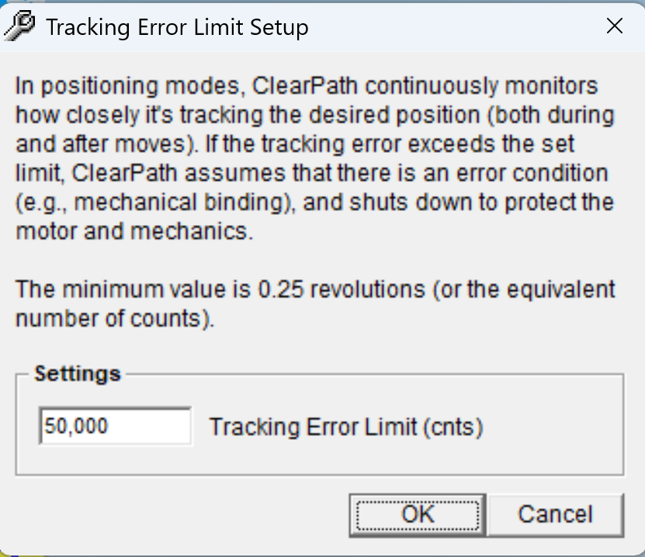
Set the tracking error limit
Set it to smth ungodly... I picked 50k, really just needs to be at / above the 100% PWM value you set later.

Slide 11
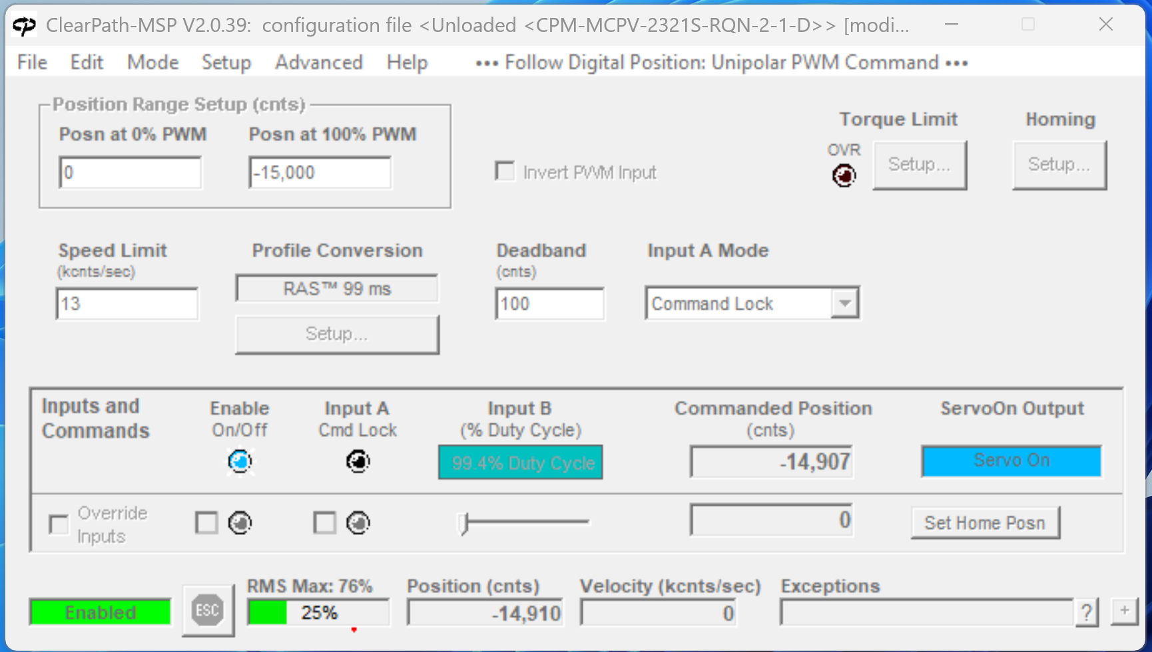
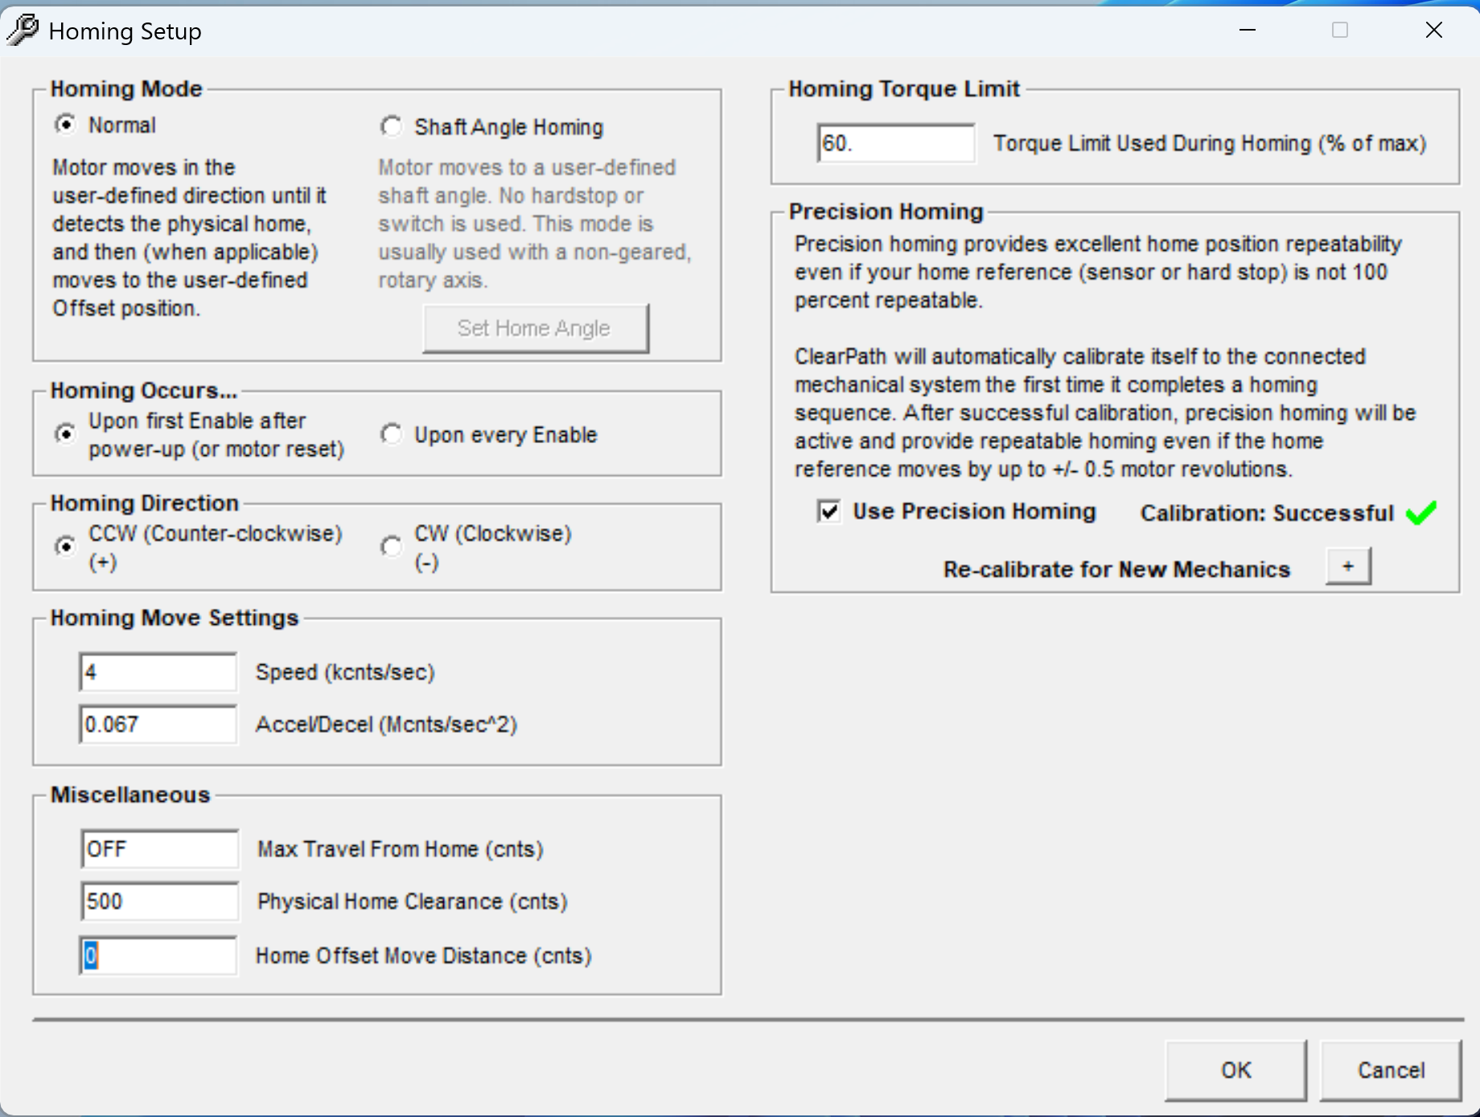
Set Homing Settings

Slide 12
Connecting Cables
!!! Make sure homing is set to CCW, otherwise the actuator may damage equipment on start.
Motor should have the output cables connected, but the 8P data connector should NOT be connected yet (8P Molex Mini-Fit JR or M12 A-Code)

Slide 13
Position Motor to True 0
Initialize motor & position to true 0.

